Slide 1

AMAZON WEB SERVICES
AWS

Slide 2
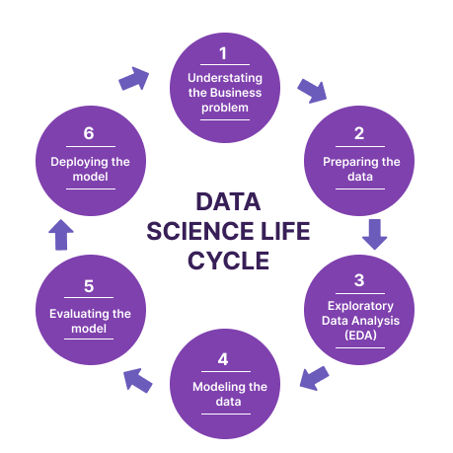
Data Science Project Steps

Slide 3
Model Deployment
Machine learning model deployment is the process of placing a finished machine learning model into a live environment where it can be used for its intended purpose.
Building a model is generally not the end of the project.
Model deployment is the process of putting machine learning models into production
Instance/ cloud creation
Python and dependencies
App configuration
Steps of Model Deployment

Slide 4
What is cloud computing ?
Cloud computing is the on-demand delivery of compute power, database storage, applications, and other IT resources through a cloud services platform via the internet, with pay-as-you-go pricing.
Instead of buying, owning, and maintaining physical data centres and servers, you can access technology services, such as computing power, storage, and databases, on an as-needed basis from a cloud provider like Amazon Web Services (AWS).

Slide 5
Advantages of cloud computing
Back-up and restore data – Once the data is stored in the cloud, it is easier to get back-up and restore the data using the cloud
Improved collaboration - Cloud applications improve collaboration by allowing groups of people to quickly and easily share information in the cloud via shared storage.
Excellent accessibility - Cloud allows us to quickly and easily access store information anywhere, anytime in the whole world, using an internet connection. An internet cloud infrastructure increases organization productivity and efficiency by ensuring that our data is always accessible.
Low maintenance cost - Cloud computing reduces both hardware and software maintenance costs for organizations

Slide 6
Services in the pay-per-use model - Cloud computing offers Application Programming Interfaces (APIs) to the users for access services on the cloud and pays the charges as per the usage of service.
Data security- Data security is one of the biggest advantages of cloud computing.
Unlimited storage capacity-Cloud offers us a huge amount of storing capacity for storing our important data such as documents, images, audio, video, etc. in one place.

Slide 7
Cloud Service Providers
Amazon Web Services (AWS)
Google Cloud Platform (GCP)
Microsoft Azure
Alibaba Cloud
Oracle Cloud
IBM Cloud (Kyndryl)
Tencent Cloud
OVHcloud
DigitalOcean
Linode (Akamai)

Slide 8
AWS – Amazon web services
AWS is a collection of remote computing services that make up a cloud computing platform, offered by Amazon.com.
AWS is a secure cloud services platform, offering computing power, database storage, and a broad set of application services.
Features of AWS
Most functionality
Largest community of customers and partners
Most secure
Fastest pace of innovation
Most proven operational expertise

Slide 9
Range of services
Computer services
Storage services
Database services
Networking and content delivery services
Security and Identity services
Analytics services
Application services
Management tools

Slide 10
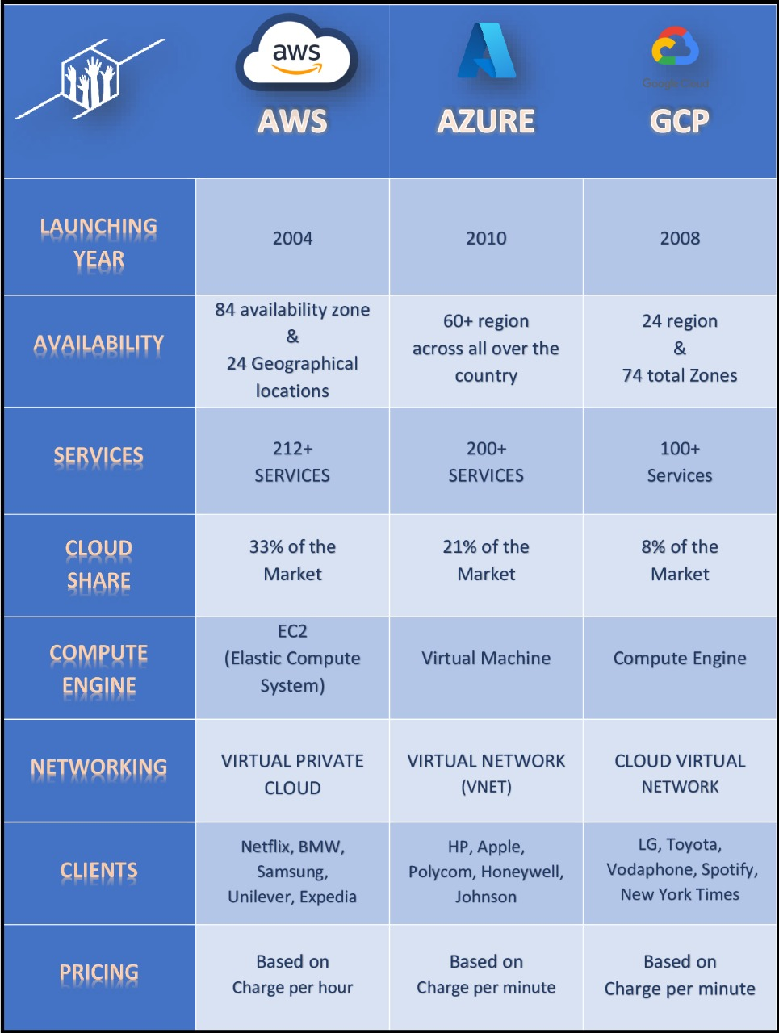
General comparison

Slide 11
AWS Global Infrastructure:
Components Of AWS Infrastructure:
1) Region
2) Availability Zones
3) Local Zones

Slide 12
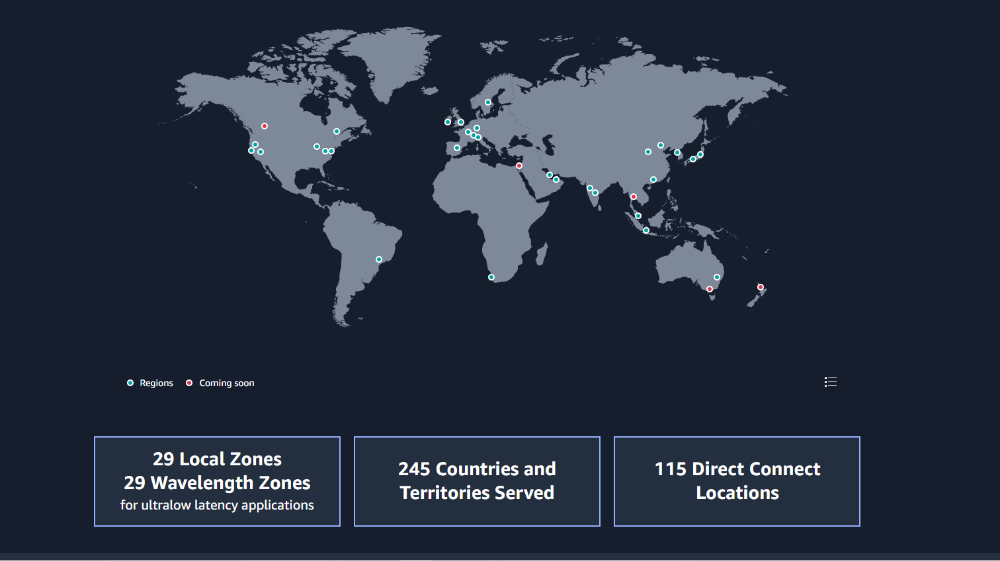
Global network of AWS Regions and availability zones

Slide 13

Conclusion
In order to start using a model for practical decision-making, it needs to be effectively deployed into production.
Cloud computing provides the most flexible and efficient way to deploy ML models.
AWS is the most popular cloud computing platform offered by the Amazon.
The AWS cloud spans 84 availability zones within 24 geographical regions around the world.

Slide 14
Thank you

